Slide 1
CMSC 635
Knowledge Discovery & Data Mining
Diabetes Data
Raid Mohaidat
Department of Computer Science, Virginia Commonwealth University
October 5, 2011

Slide 2
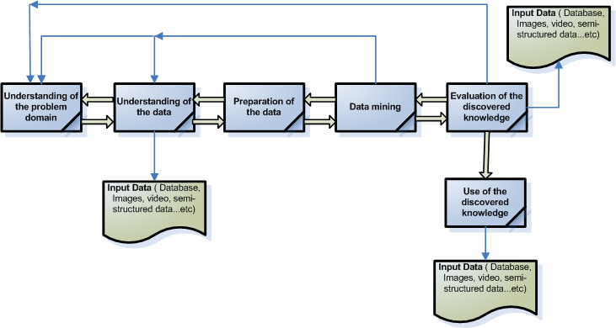
Knowledge Discovery Overview

Slide 3
Understanding Problem Domain
Purpose of the project is to identify the kind of a successful treatment for diabetes patients.
Indicator of a successful treatment is measured by weather an inpatient was discharged to home or not
The kind of treatment to be identified through various features extracted out of the database provided (Jan2000-Jun09)

Slide 4
Understanding of the data
(Encounter_facts, Daignosis_facts, procedure_facts , medication_facts and laboratory_facts)
Based on the Admitt and Discharge dates in the encounter table, the average number of days for an inpatient is 6.5 days
Smaller representative data set
Sample dataset to be used from (07/01/2007-06/30/2009)”275800” records

Slide 5
Understanding of the data
The latest data set will more likely have better performance , improved treatment methods in place when compared with older datasets, in addition to newer technologies in place for monitoring and accuracy of doses and more complete data

Slide 6
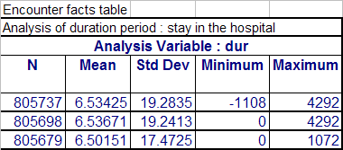
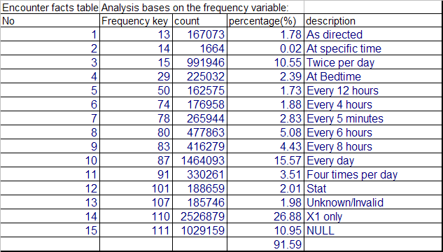
Understanding of the data

Slide 7
Understanding of the data
Admitting physician is complete with valid information in the Encounter table
Patient gender analysis: 53% (Female) of which 53% were discharged, ( 47%) Male of which 58% were discharged, 34 cases (0.004%) w/out gender information.
Age, Average=65 → (0,90]

Slide 8
Tools and methods being used in the project
Using Weka for most of the project
SQL for further analysis

Slide 9
Preparation of the data
Identifying and removing outliers
Identifying records with missing values
Identifying records with invalid data
Using PCA for data extraction
Candidate features:
  Gender of the patient
  age of the patient
  Admitting physician Id

Slide 10
Preparation of the data
Candidate features:
  admitting type id
  Duration of stay at the hospital
  lab_process_time (order->results)
  Lab results
  M_ordering physician
  M_frequency
  M_dose quantity
  M_infusion rate
  M_order strength
  M_duration( started –> stopped)

Slide 11
Data mining
Work to be done

Slide 12
Evaluation of the discovered knowledge
Work to be done

Slide 13
Use of the discovered knowledge
Work to be done

Slide 14
Questions and comments
Questions ?
Comments or suggestion!

